Slide 1
What Is System Reliability And How To Estimate?
Lecturer : Amir M . Pirhosseinloo
Professor : Dr. Safabakhsh

Slide 2
Overview
1.Introduction
Bayesian Networks, System Reliability, Traditional Approaches, Challenges
2.Implementation of the K2 algorithm
Dataset, Notations, Pseudo code
3.Illustrative step by step example
Building BN, Estimating Reliability
4.Experimental analysis
Performance, Accuracy, Error rate
5.Conclusion

Slide 3
Introduction

Slide 4
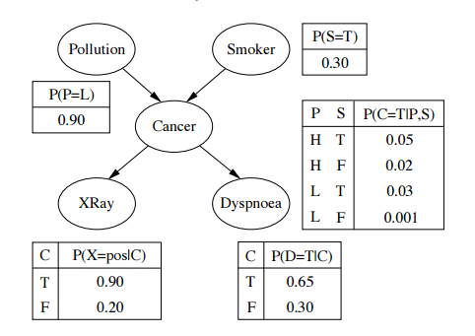
Bayesian Networks
What is a Bayesian Network ?
DAG: Directed Acyclic Graph
Nodes: System Components
Edges: Relations
www.math.stackexchange.com/questions/1709832/confusion-in-a-simple-bayesian-network

Slide 5


System Reliability
www.verifyrecruitment.com/blog/index.php/site-reliability-engineer/
Probability
Intended function
Specific period of time
Stated condition
www.spark.apache.org/docs/latest/cluster-overview.html

Slide 6
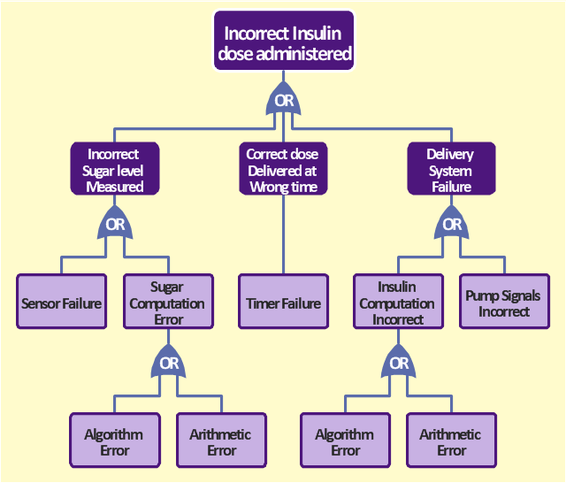
Traditional Approaches
Fault trees
Minimal cut sets
Minimal path sets
Gran and Helminen
Nuclear power plants
Software system
Plant hardware
Halden project (HRP)
Amasaki – software quality assessment
Requires domain experts to
Evaluate prior probabilities
Understand the structure of BN.
Construct the BN
www.conceptdraw.com/a1579c3/preview

Slide 7

Challenges
System domain specific
Finding relations between components
Systems evolve
Finding domain expert
Difficult
Costly
Unintentional mistakes
Need for keeping same expert
www.technologynetworks.com/informatics/lists/7-data-challenges-in-the-life-sciences-288265

Slide 8
Implementation Of The K2 Algorithm

Slide 9
Dataset for example
observation | X₁ | X₂ | X₃ | X₄ | X₅ | system behavior
1 | 1 | 1 | 0 | 0 | 0 | 0
2 | 0 | 1 | 1 | 1 | 1 | 1
3 | 1 | 1 | 0 | 1 | 1 | 1
4 | 0 | 0 | 0 | 0 | 0 | 0
5 | 1 | 0 | 1 | 0 | 0 | 1
6 | 0 | 0 | 0 | 0 | 0 | 0
7 | 1 | 1 | 0 | 1 | 1 | 1
8 | 0 | 1 | 1 | 1 | 1 | 1
9 | 1 | 0 | 1 | 0 | 0 | 1
0 | 0 | 0 | 0 | 0 | 0 | 0

Slide 10

Notations
α_{ijk}
α_{ij}
π_{i}
q_{i}
d_{i}
$P\left(A\right)$
$P\left(A | B\right)=\frac{P\left(A,B\right)}{P\left(B\right)}$
$P\left(A | B,C\right)=\frac{P\left(A,B,C\right)}{P\left(B,C\right)}$
$P\left(A | B,C\right)=P\left(B,C|A\right)∗\frac{P\left(A\right)}{P\left(B,C\right)}$

Slide 11
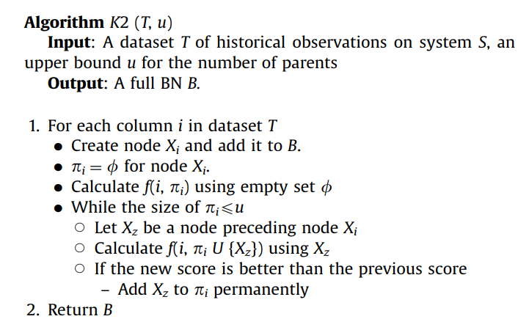


Pseudo Code
Machine learning algorithm
Scoring function
Heuristic function
Efficient(polynomial time) $O(n2$)
System specific
Historical data about the system
$$f(i,πi\text{) =} \prod_{j=1}^{qi}{\frac{\left( di −1 \right)!}{\left(αij + di −1\right)!} \prod_{k=1}^{di}{αijk!}}$$
Output depends on initial linear ordering of components.

Slide 12
Illustrative Step By Step Example

Slide 13
Dataset for example
observation | X₁ | X₂ | X₃ | X₄ | X₅ | system behavior
1 | 1 | 1 | 0 | 0 | 0 | 0
2 | 0 | 1 | 1 | 1 | 1 | 1
3 | 1 | 1 | 0 | 1 | 1 | 1
4 | 0 | 0 | 0 | 0 | 0 | 0
5 | 1 | 0 | 1 | 0 | 0 | 1
6 | 0 | 0 | 0 | 0 | 0 | 0
7 | 1 | 1 | 0 | 1 | 1 | 1
8 | 0 | 1 | 1 | 1 | 1 | 1
9 | 1 | 0 | 1 | 0 | 0 | 1
10 | 0 | 0 | 0 | 0 | 0 | 0

Slide 14


f score for all possible candidate parent sets of X₃
parent set | f score
{} | 1/2772
{X₁} | 1/3600
{X₂} | 1/3600
{X₁,X₂} | 1/144

Slide 15
Result Of K2 Algorithm
X1
X2
X4
X3
X5
System behavior
Fig. 1

Slide 16
CPT Of The X₃ Node
parents |  | probability
X₁ | X₂ | X₃ = 0 | X₃ = 1
0 | 0 | 1 | 0
0 | 1 | 0 | 1
1 | 0 | 0 | 1
1 | 1 | 1 | 0

Slide 17

Probability Of Success Calculation For Node X₃
$$p\left(X3=1\right)= \sum{p\left(X1,X2,X3=1\right)=}$$
$$p\left(X1=0,X2=0,X3=1\right)+p\left(X1=0,X2=1,X3=1\right)+p\left(X1=1,X2=0,X3=1\right)+p\left(X1=1,X2=1,X3=1\right)=0.5 ∗0.5 ∗0+0.5 ∗0.5 ∗1+0.5 ∗0.5 ∗1+0.5 ∗0.5 ∗0=0.5$$

Slide 18
CPT Of The System Behavior Node
parents |  | probability
X₃ | X₅ | System Behavior = 0 | System Behavior = 1
0 | 0 | 1 | 0
0 | 1 | 0 | 1
1 | 0 | 0 | 1
1 | 1 | 0 | 1

Slide 19
Experimental Analysis

Slide 20
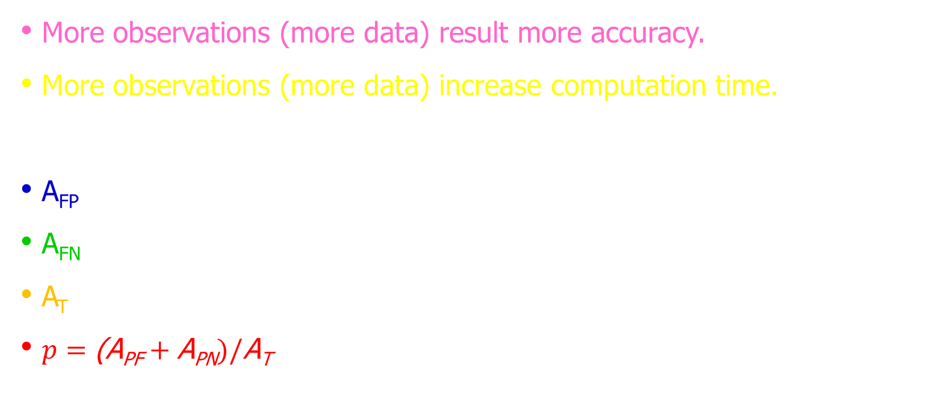
How To Increase Performance ? How To Reduce Error Rate ?
More observations (more data) result more accuracy.
More observations (more data) increase computation time.
Trade OFF
A_{FP}
A_{FN}
A_{T}
$p=\text{(}\text{A}\text{PF}+\text{A}\text{P}\text{N})/\text{A}\text{T}$

Slide 21
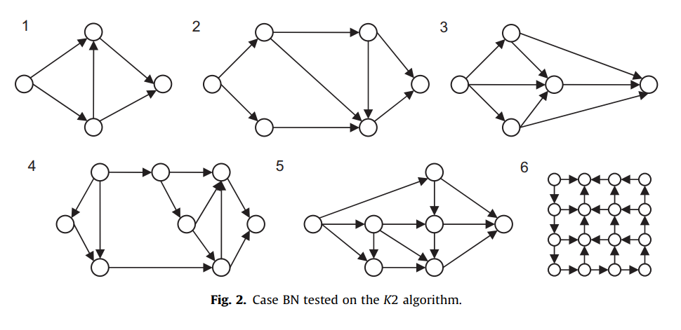
Some BNs For Test K2 Algorithm

Slide 22
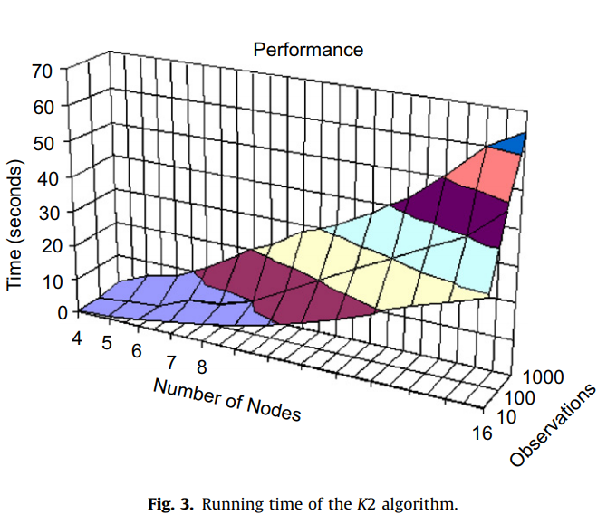
Performance-Runtime Chart

Slide 23
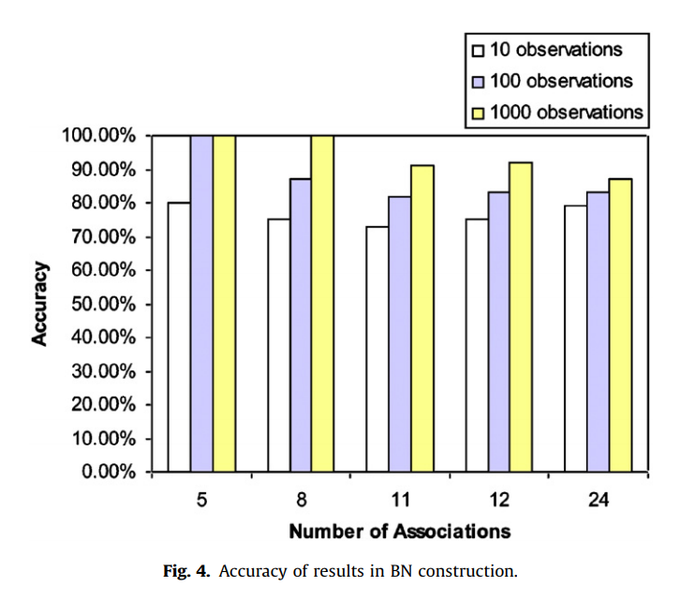
Accuracy-Association Chart

Slide 24
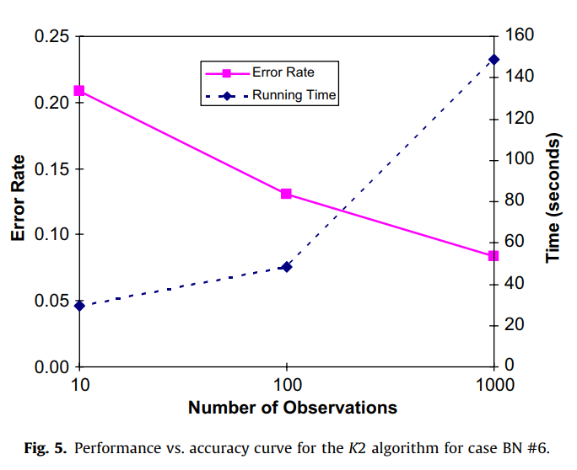
Error Rate - Time Chart

Slide 25
Conclusion

Slide 26
Conclusion
Numerous method for estimating reliability but challenges still remained
K2 algorithm:
No need to domain expert
But needs historical data about the system
Efficient for substantially large systems
Can further be improved when the already existing associations between components are taken in to account(needs a domain expert of the system)

Slide 27
References
Ozge Doguc , Jose Emmanuel Ramirez-Marquez.A generic method for estimating system reliability using Bayesian networks.(February 2009).
Christopher M. Bishop.(2006).Pattern Recognition and Machine Learning.
Stuart J. Russell and Peter Norvig. Artificial Intelligence A Modern Approach 3th Edition.
Helge Langseth , Luigi Portinale. Bayesian networks in reliability.(19 January 2006).
Sankaran Mahadevan ,Ruoxue Zhang , Natasha Smith.Bayesian networks for system reliability reassessment.(2001).

Slide 28
?

Slide 29
Thank you

